Slide 1



Lecture 21
Chemical Engineering for Micro/Nano Fabrication

Slide 2

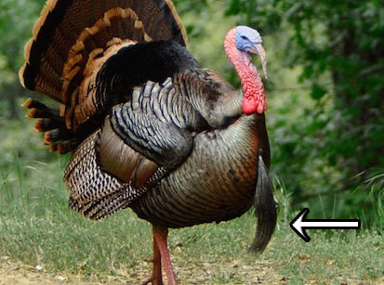
Snoods??..Beards???..Wattles??
http://mentalfloss.com/article/53730/whats-thing-hangs-turkeys-face
https://tpwmagazine.com/archive/2005/nov/skillbuilder/

Slide 3
Relative Etch Rate of Polymers
Aliphatic
Aromatic
Relative Etch Rate

Slide 4
Chemical Amplification
Insoluble
hν
Soluble
Φ < 1
Generator
hν
Φ < 1
Catalyst
Insoluble
Soluble + Catalyst

Slide 5
Chemically Amplified Deep UV Resists
Photoacid Generation
with
acid
without
acid
Mass
hν
H⁺⁻SbF₆
S⁺⁻SbF₆
100
150
200
250
300
Temperature (°C)
Acid-Catalyzed Deprotection
CH₂
CH
CH₂
CH
n
n
H⁺
+
CO₂
Δ
OH
O
O
+
H⁺
+
CH₂=C
CH₃
protecting
group
O
CH₃

Slide 6
Design Considerations
Dissolution by etching prevents swelling
Incorporates Catalysis to achieve high sensitivity
Employs polyphotolysis for high contrast
Can be developed in either tone
High transparency for steep walls.
Aromatic polymer provides dry etch resistance
High activation energy provides storage stability

Slide 7
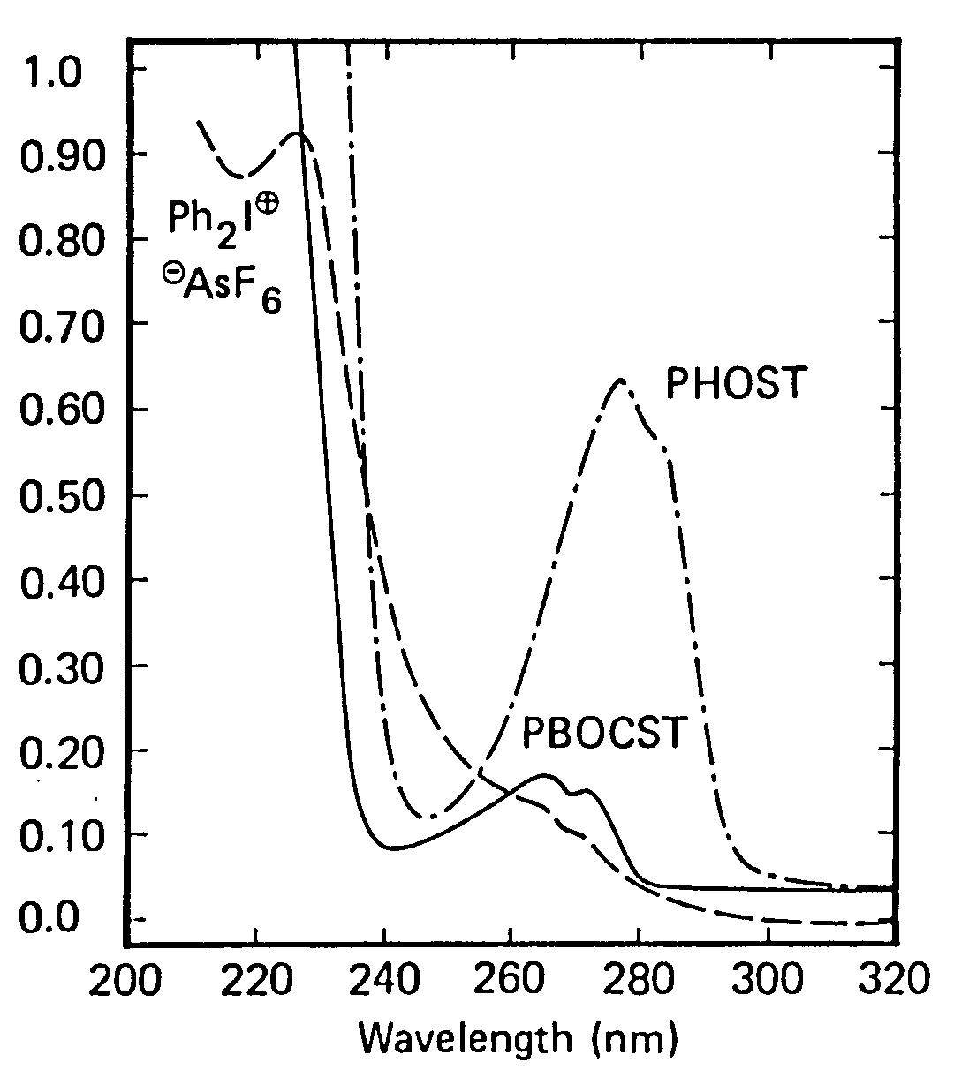
Optical Density
Absorbance

Slide 8
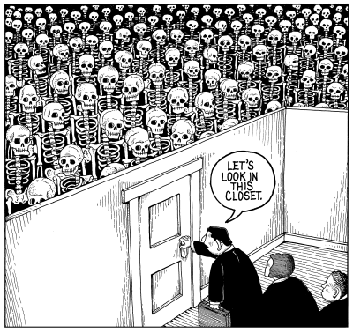
Remember the Skeleton in the Closet

Slide 9
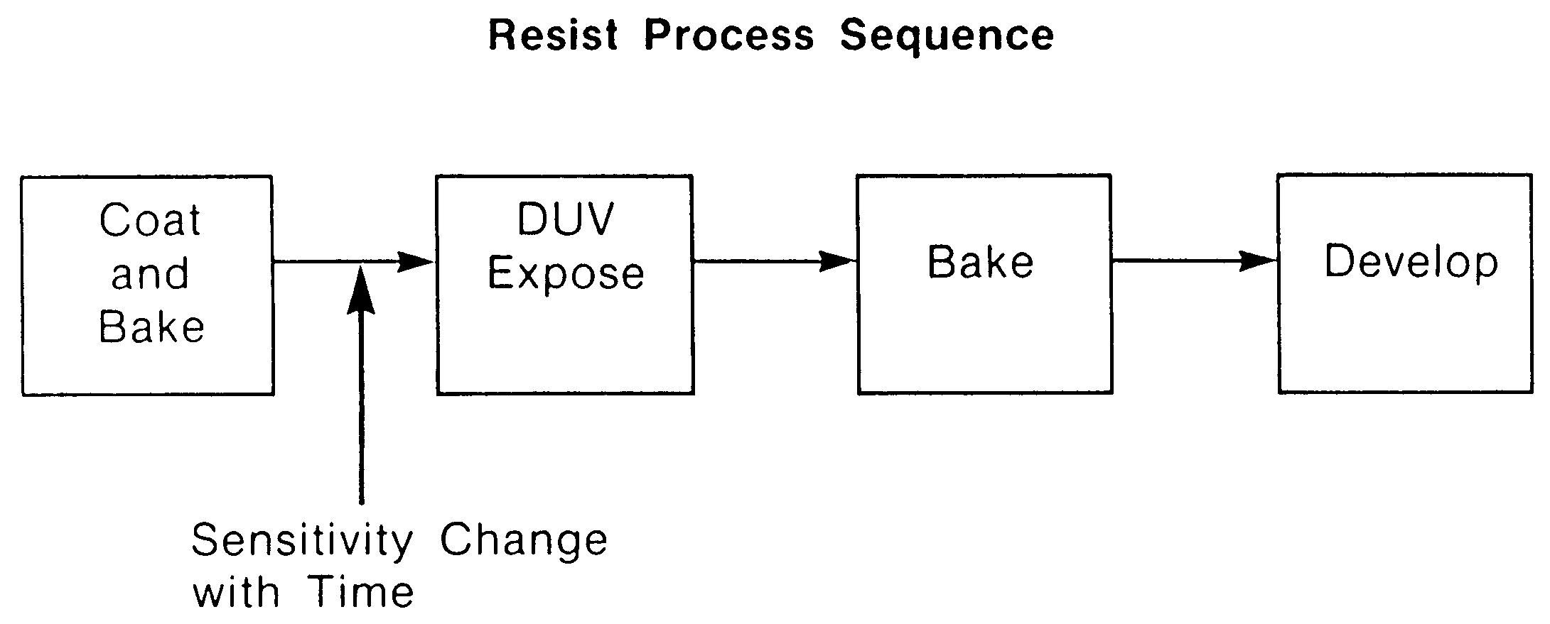

Slide 10
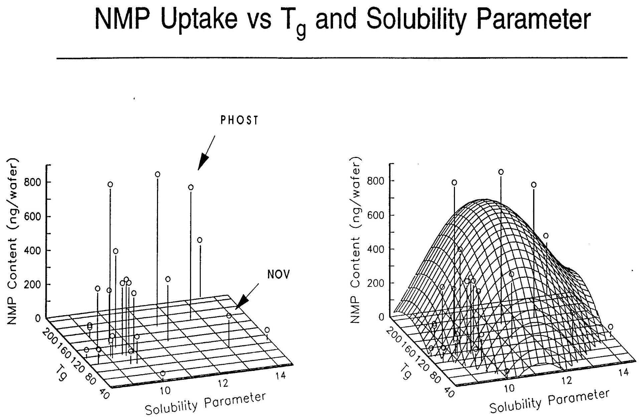

Slide 11
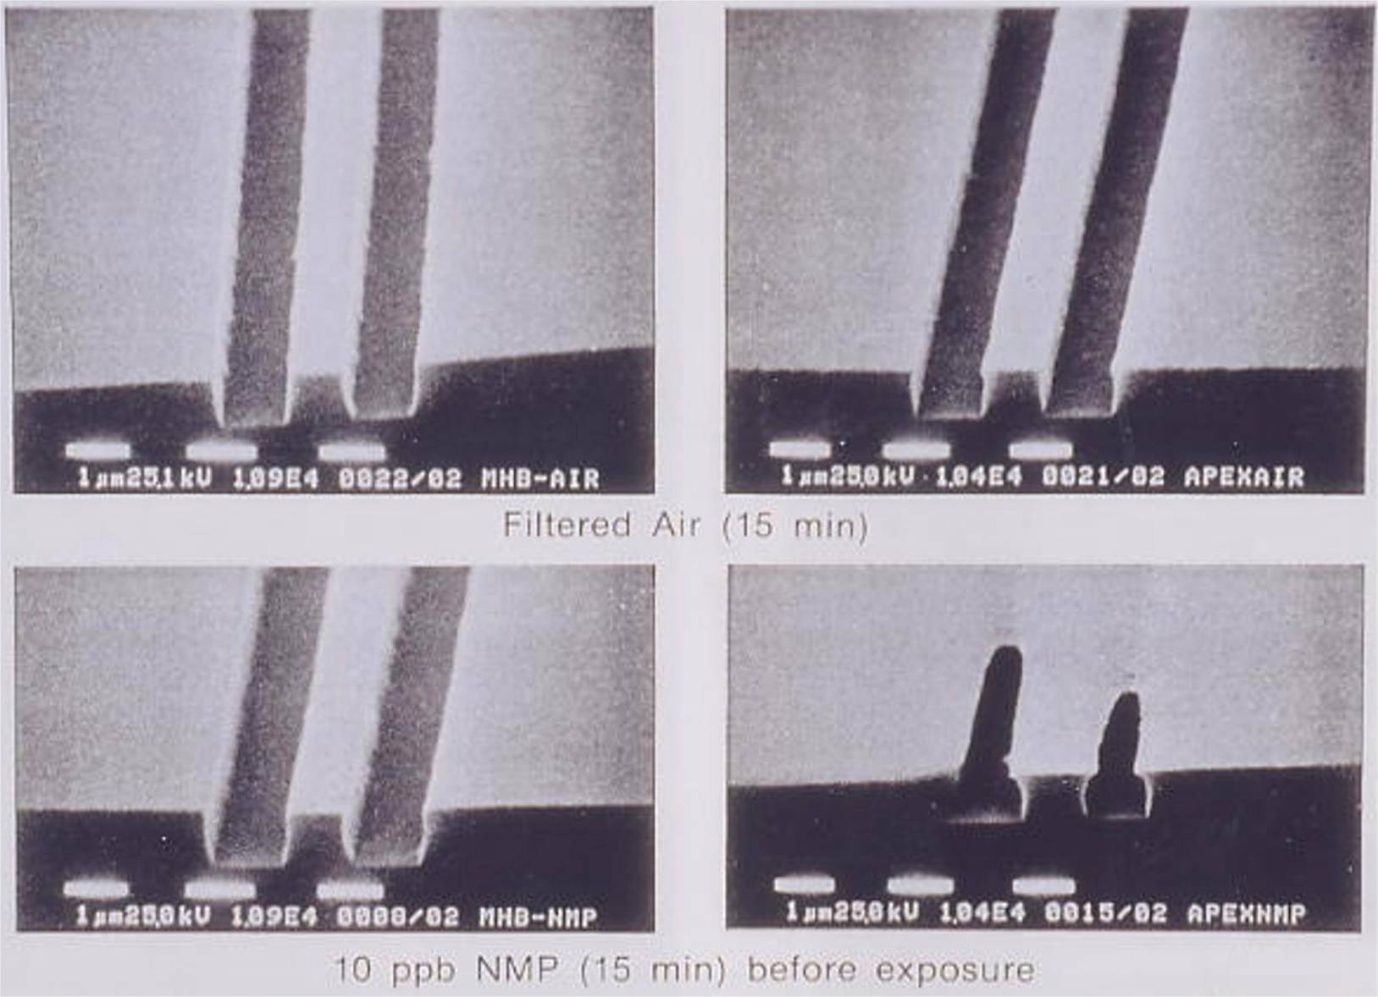
Effects of filtered air (top) and 10ppb NMP (bottom) on positive images printed in the meta- (left) and para- (right) P(HOST-co-BOCST) resists.

Slide 12
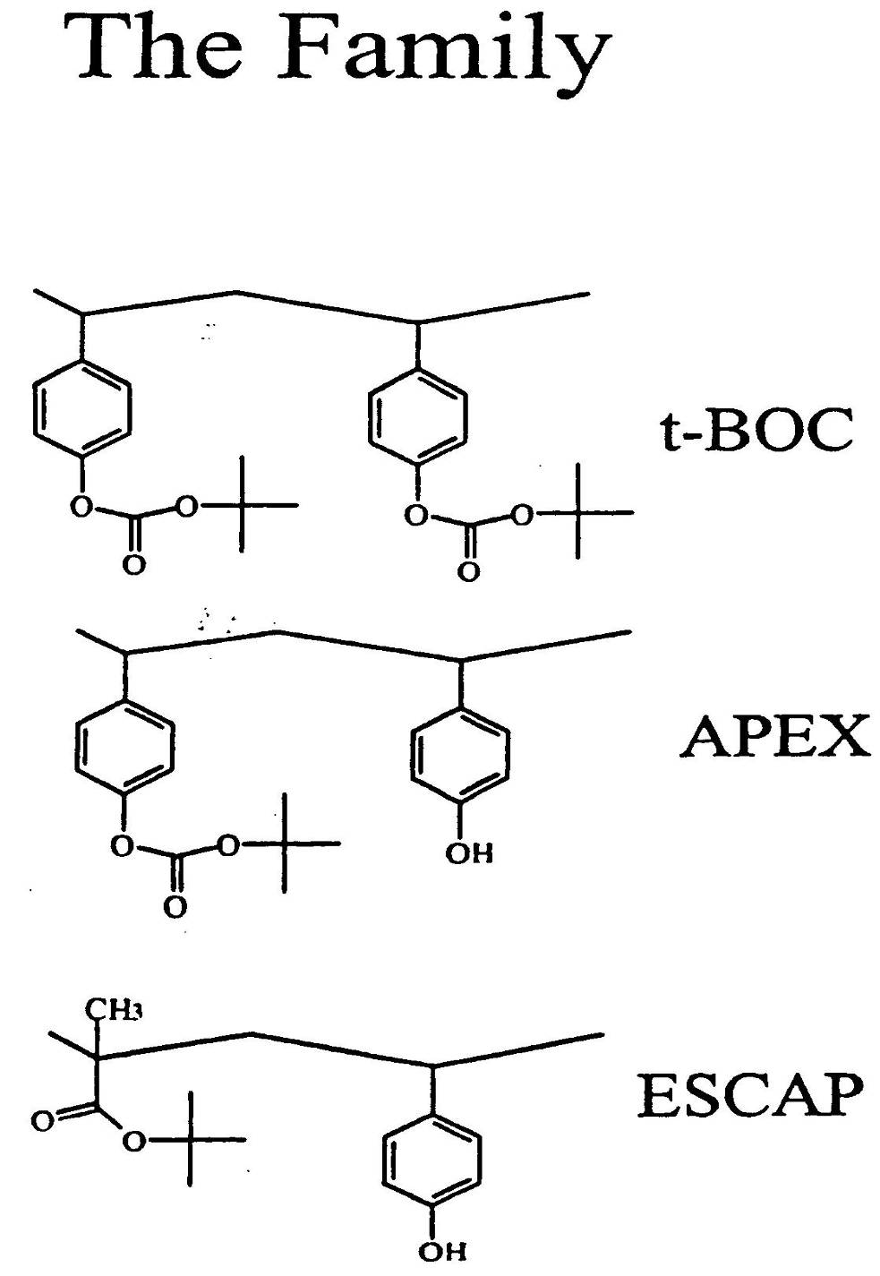
The “Family”

Slide 13
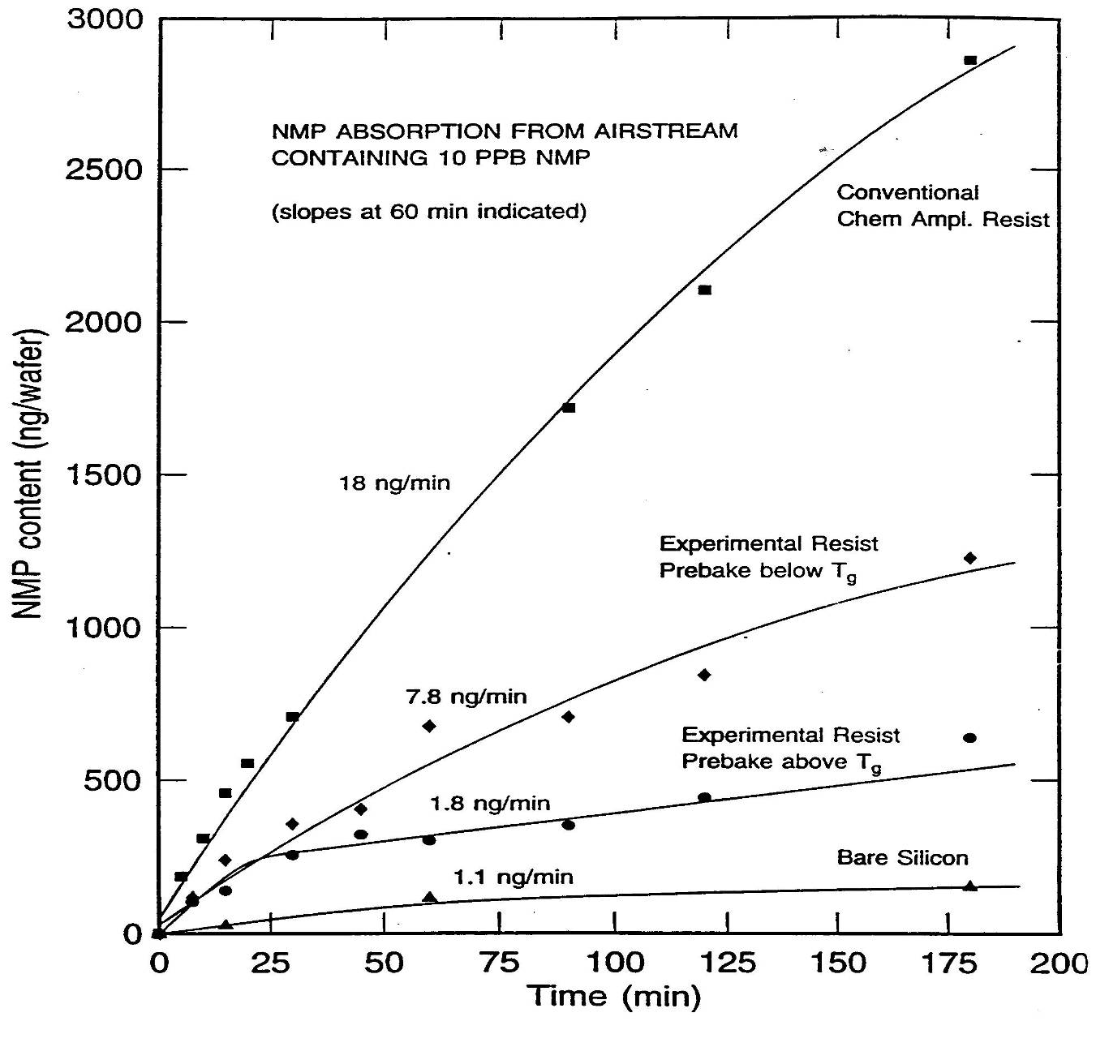

Slide 14
ESCAP
Acrylic reduces solubility of NMP
Acrylic ester more thermally stable than the t-butyl carbonate
Enables post apply bake Temp > Tg
Bake > Tg decreases permeance
Hiroshi Ito, IBM

Slide 15
Next:
193nm Lithography

Slide 16
Relative Etch Rate of Polymers
Aliphatic
Aromatic
Relative Etch Rate

Slide 17
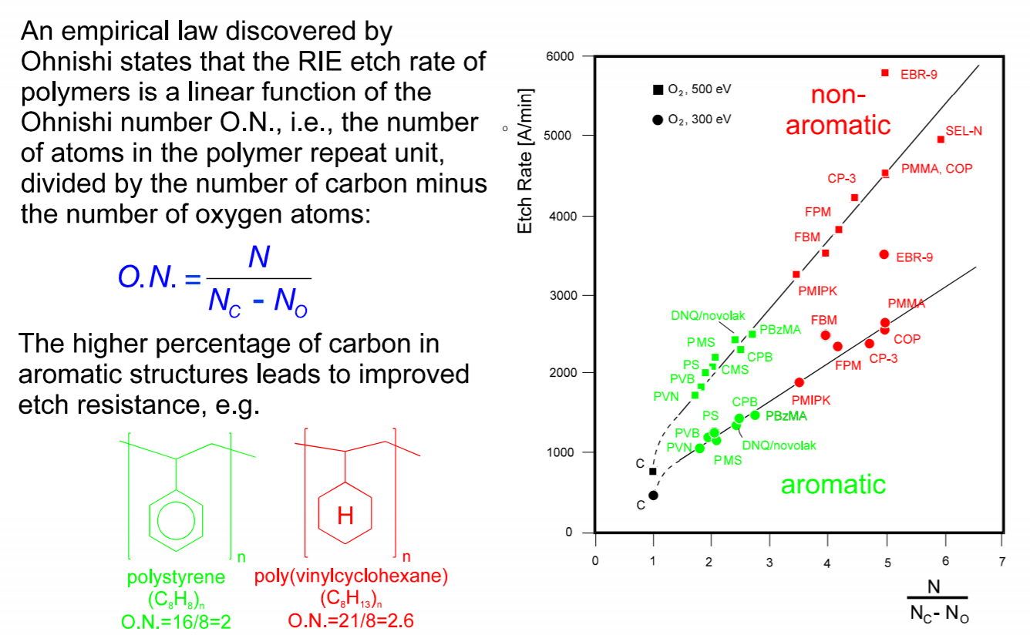
The Ohnishi Number
Watanabe, F. and Ohnishi, Y., J. Vac. Soc. Technol. B,422 (1986)

Slide 18
Absorption of Photoresist Polymers
2.8
Poly-(4-hydroxystyrene)
2.4
Meta-cresol novolak
2.0
ArF
193 nm
KrF
248 nm
i-line
365 nm
1.6
Absorption coefficient [1/µm]
1.2
0.8
Polyacrylates
(aliphatic)
0.4
0.0
175
200
225
250
275
300
325
350
375
400
Wavelength [nm]
Source: R.D. Allen et al., IBM J. Res. Develop. 41 (1/2), 95-104 (1997)

Slide 19
Relative Etch Rate of Polymers
Aliphatic
Aromatic
Relative Etch Rate
Carbon

Slide 20
193 nm Resist Materials
Challenge:
248 and 365 nm resists are unsuitable for 193 nm imaging because they are opaque at this wavelenth
Etch resistance requires high carbon/hydrogen ratio but aromatics are precluded because of their absorption
How do you achieve both 193nm optical transparency and etch resistance?

Slide 21
High C:H Ratio of Alicyclic Hydrocarbons
The key!
Structure:
Formula:
Unsaturation
Number:

Slide 22
APEX 248nm Resist Design
Tethering Function
Acid Lability
Base Solubility
Etch Resistance

Slide 23
UTexas193nm Design
[
]
[
]
C
O
C
O
O
OH
C(CH₃)₃
Tethering Function
Acid Lability
Base Solubility
Etch Resistance

Slide 24
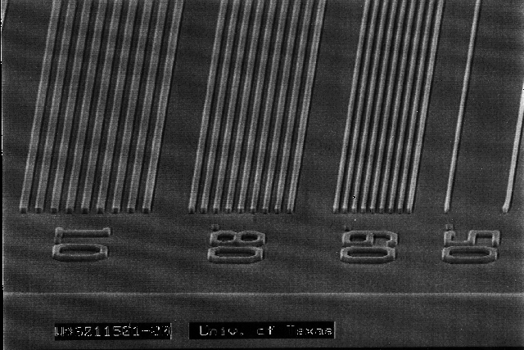
Early Lithography
Resist
+ Ø₃SSbF₆
poly(NBCA-co-CBN)
Excellent image quality
Adhesion failure
Synthesis requires metal catalyst!

Slide 25
Trading Etch Resistance for Adhesion:
Alternating Systems: COMA
V601
Yield :
M_{n} :
M_{w} :
Pd :
60%
4,660
6,860
1.472
Waco Chemical
No Metal!
Shelf Life issues?

Slide 26
Images in UT 193nm COMA Resist
Alternating co-polymer
Uzo Okoroanyanwu, Jeff Byers

Slide 27
Improving Etch Resistance
DNBC
Yield :
M_{n} :
M_{w} :
Pd :
55 %
3,400
4,340
1.276
UV Absorbance
0.44 μm⁻¹
@ 193 nm
With JSR

Slide 28
Resist and Process Development
Basic
Chemistry
Formulation and Process Development
Optimization
I-line
248nm
Performance
193nm Issues!
Time

Slide 29
Fujitsu’s Acrylic Platform
Acrylate Copolymers …
Free radical polymerizations
No metal

Slide 30
Acrylic Polymer Platform
Fujitsu
IBM,JSR, etc.

Slide 31
Types of PAGs Used For 193 nm Lithography
IONIC
NON-IONIC
R
VOLATILE
O
TPS
R
O
F
C
S
-
SIT
O
O
S
A
DPI
3
3
N
r
+
+
O
S
I
-
S
O
O
R
3
R
O
O
MDT
O
NON-VOLATILE
N
O
S
C
F
ALS
+
-
-
3
R
S
O
A
O
S
sF
f
3
O
6
C
H
3
C
F
C
F
MBT
2
C
F
2
S
O
-
O
C
F
C
H
3
2
3
3
+
“nonaflate”
NEALS
S
O
O
O
O
S
H
O
P
-
NAT.OTf
F
O
6
O
O
N
O
S
C
NIT
F
: too weak
for 193 nm
3
S
O
O₃⁻
O

Slide 32
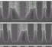
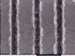
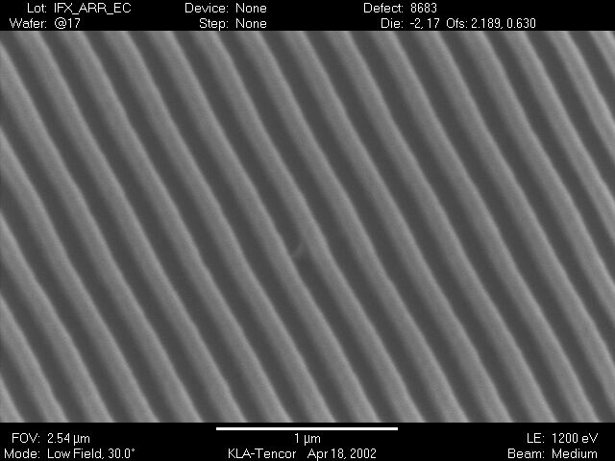
193nm Resist Challenges
Pattern Collapse
Line Edge Roughness (LER)
Etch Resistance
Heisenberg Principle issue
New Defect Types
Pattern Collapse
μ Bridging
LER

